Slide 1

Intro to Computer Science
DEMI G4S1-Lesson 3–Sprites in Action (Events).
الجلسة التطبيقية: الثالثة
المستوى: الثالث

Slide 2
Robotics Adventures: Innovate and Create
DEMI G6S3 - Lesson 01 - Navigating a Maze

Slide 3
Introduce yourself
Tell us your name, age/grade, and your hobbies
Spin the wheel
Open the random wheel
Answer the random question on the screen
Notes:
https://wheelofnames.com/eqj-8zc

Slide 4


Slide 5
Bumper Sensors
Use Control Blocks
Navigate The Maze

Slide 6
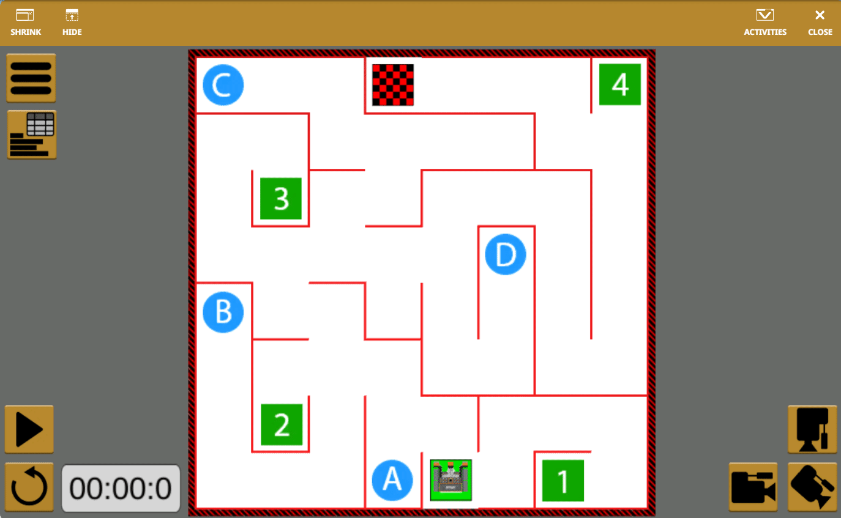
Our Goal Today

Slide 7
Why Sensors Matter in Robotics?

Slide 8
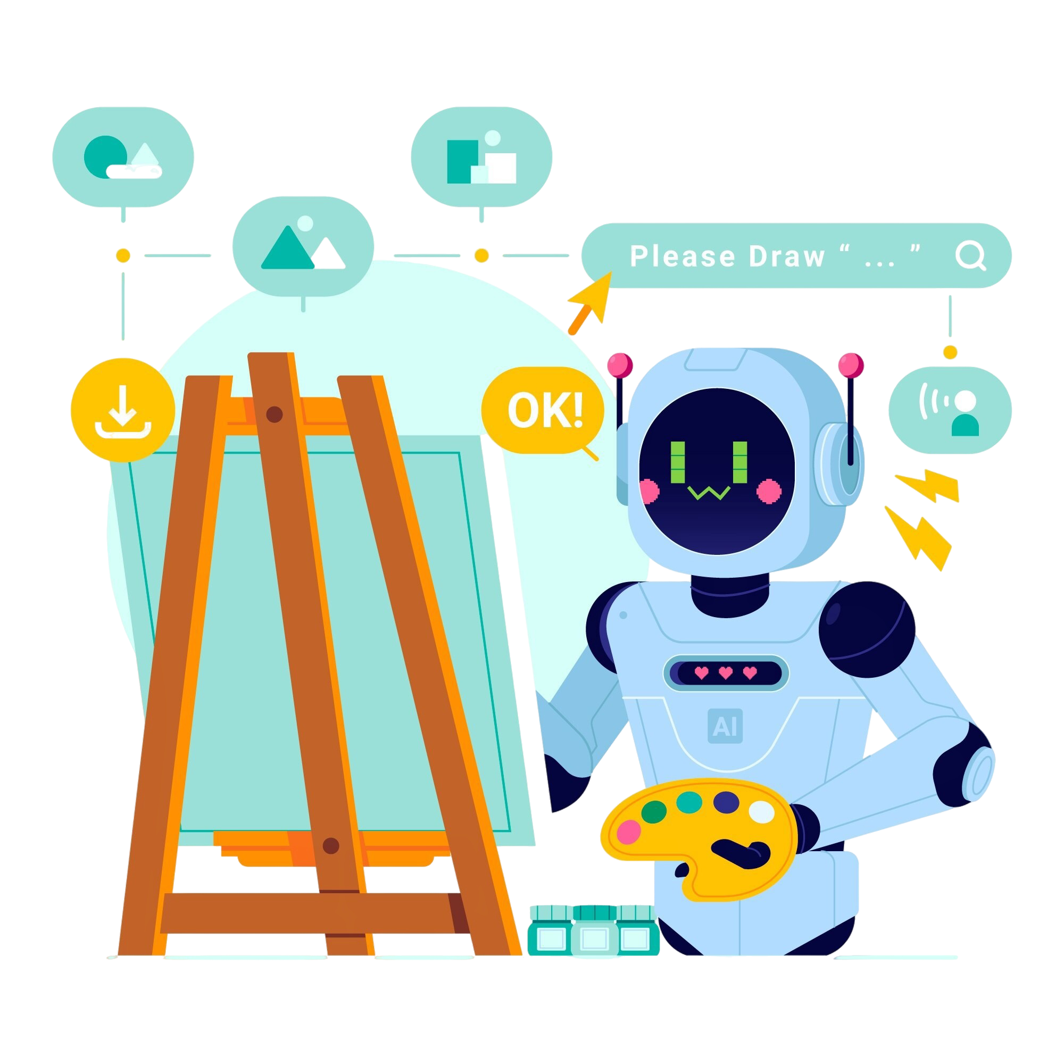
What Are Sensors?
Sensors are special tools that give robots incredible abilities to feel and understand their surroundings, just like your senses!

Slide 9

What Are Sensors?
Just like your eyes help you see and your hands help you touch, sensors help robots explore and discover what's around them.

Slide 10

Why Sensors Matter in Robotics
Environmental Awareness
Sensors allow robots to "see" and understand their surroundings, detecting obstacles and changes

Slide 11

Why Sensors Matter in Robotics
Dynamic Decision Making
Robots can respond to changing conditions rather than following fixed instructions

Slide 12

Why Sensors Matter in Robotics
Real-World Interaction
Sensors enable robots to interact with physical objects and adapt their behavior

Slide 13
For a robot to truly be intelligent, it must follow the Sense-Think-Act decision loop

Slide 14
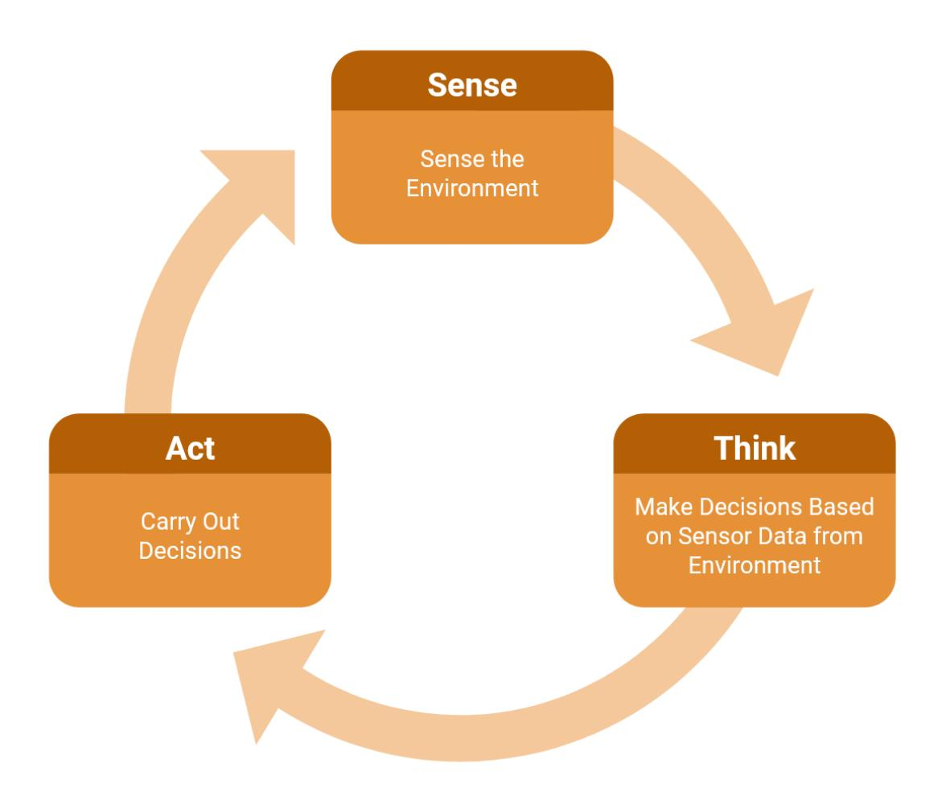
The Sense-Think-Act Loop

Slide 15
The Sense-Think-Act Loop

Slide 16
The Sense-Think-Act Loop

Slide 17
The Bumper Sensor

Slide 18
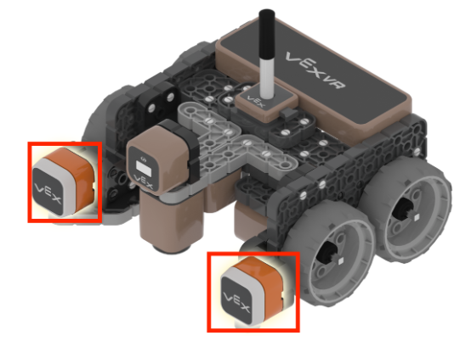
The Bumper Sensor
Location
Function
The VR Robot has two Bumper Sensors located on the front of the robot
Detects when the robot makes physical contact with walls or objects
Notes:
The Bumper Sensor is your robot's sense of touch. Your VR Robot has two Bumper Sensors positioned on the front - one on the left side and one on the right side. These sensors detect when the robot makes physical contact with walls or objects in the maze. Think of them like the bumpers on a bumper car at an amusement park - they detect collisions. The front placement is strategic because the robot drives forward, so it needs to detect obstacles in its path.

Slide 19
The Bumper Sensor
Left Bumper Sensor
Right Bumper Sensor
Detects contact on the left side of the robot's front
Used when approaching walls from the left
Detects contact on the right side of the robot's front
Used when approaching walls from the right
Notes:
Your VR Robot has two separate Bumper Sensors - one on the left and one on the right. Why two? Because the robot needs to know which side is making contact with a wall. If the left bumper is pressed, the robot might turn right to avoid the obstacle. If the right bumper is pressed, it might turn left. Having two sensors gives your robot more information about its environment and allows for more sophisticated navigation strategies. In your code, you'll specify which bumper you're checking - left or right.

Slide 20
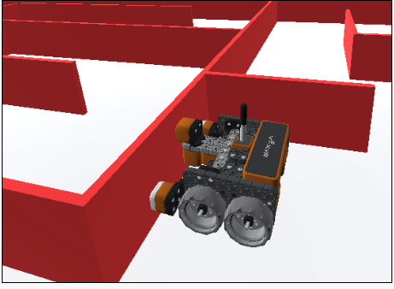
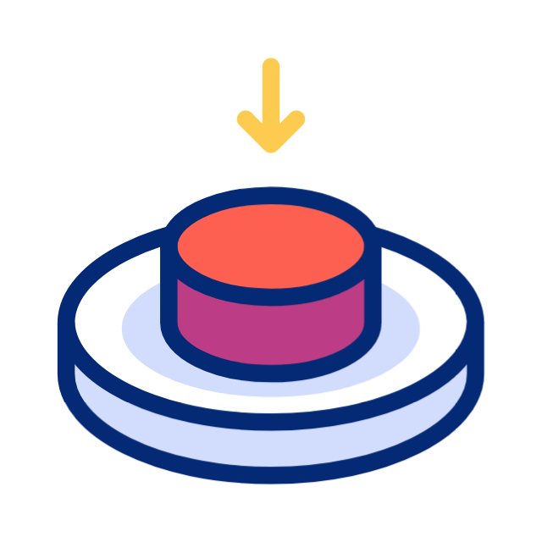
Bumper Sensor as a Switch
A Bumper Sensor is a type of switch that reports if it is pressed or released
Notes:
The Bumper Sensor is classified as a switch, which is the simplest type of sensor. A switch has only two possible states - just like a light switch can be either on or off. For the Bumper Sensor, these states are "pressed" (when touching a wall) and "released" (when not touching anything). There's no in-between - the sensor can't be "a little bit pressed." This binary nature makes Bumper Sensors reliable and easy to program. You always know exactly what state the sensor is in.

Slide 21
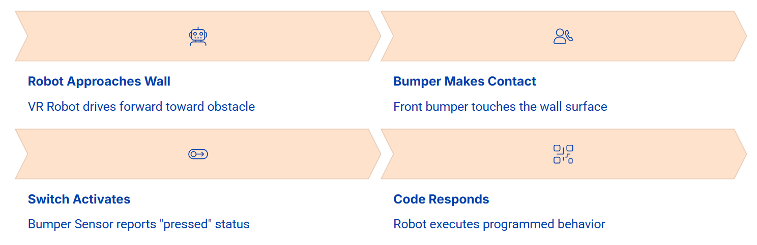
How Bumper Sensors Work
Notes:
Let's understand the sequence of how Bumper Sensors work. First, your robot drives forward toward a wall.

Slide 22
How Bumper Sensors Work
Notes:
As it gets closer, the front bumper makes physical contact with the wall surface.

Slide 23
How Bumper Sensors Work
Notes:
This contact activates the Bumper Sensor, which is actually a type of switch.

Slide 24
How Bumper Sensors Work
Notes:
The sensor then reports a "pressed" status to your code. Finally, your code can respond to this information by stopping, turning, or performing any other programmed behavior. This entire process happens very quickly - in milliseconds!

Slide 25
Boolean Logic with the Bumper Sensor

Slide 26


Bumper Sensor Boolean Values
Pressed State
Bumper is touching a wall
Robot should respond (turn, stop, back up)
Not Pressed State
Bumper is not touching anything
Robot can continue driving forward
Notes:
Let's clarify the two states of the Bumper Sensor. "Pressed" means the bumper is physically touching a wall - this state reports TRUE. When pressed, your robot should respond by stopping, turning, or backing up. "Not pressed" means the bumper is not touching anything - this state reports FALSE. When not pressed, your robot can safely continue driving forward. Understanding this distinction is crucial for programming navigation. Your code will constantly check: "Is the bumper pressed?" and respond accordingly. The robot's behavior changes based on whether the answer is TRUE or FALSE.

Slide 27

Boolean Conditions in Code
The Bumper Sensor pressed block is a Boolean reporter block. It reports TRUE if the Bumper is pressed, and FALSE if it is not pressed.
This hexagonal-shaped block fits into other blocks that accept Boolean conditions, allowing your code to make decisions based on sensor values.
Notes:
In VEXcode VR, the Bumper Sensor pressed block is what we call a Boolean reporter block. Notice its hexagonal shape - this shape indicates it reports a Boolean value (TRUE or FALSE). This block constantly checks the bumper's state and reports the current value. You'll place this hexagonal block inside other blocks that accept Boolean conditions, like the [Wait until] block. The hexagonal shape is a visual cue that helps you identify Boolean blocks. When you see this shape, you know it's checking a condition that can only be TRUE or FALSE.

Slide 28

Boolean Logic in Everyday Life
Automatic Doors
Sensor checks: "Is someone approaching?" TRUE = open door, FALSE = keep closed

Slide 29
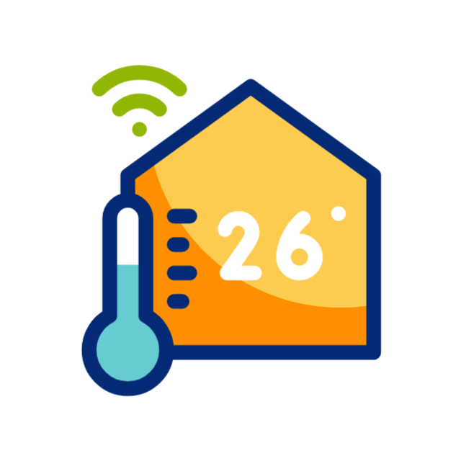
Boolean Logic in Everyday Life
Thermostats
Checks: "Is temperature below setting?" TRUE = turn on heat, FALSE = stay off

Slide 30

Boolean Logic in Everyday Life
Motion Lights
Checks: "Is motion detected?" TRUE = turn on light, FALSE = turn off light

Slide 31
Time For Our Activity

Slide 32
Bumper Walk
Divide into 5 teams (4 students each)
Roles (Mission for each role):
Robot (Blind): Keep your eyes closed (or wear a blindfold). Move forward slowly and freeze instantly when you hear “PRESSED!”
Bumper: Walk in front of the robot and touch the wall first to signal contact safely
Caller (Coder): Give the commands in order: “Forward → Wait until Pressed → Back (1 step) → Turn Right → Forward”
Judge (Debugger): Watch for mistakes; if the robot moves after “PRESSED!”, call “Restart!” and track restarts

Slide 33
Bumper Walk
Rules:
When the bumper touches a desk/chair (wall), shout “PRESSED!” and the robot must stop
After “PRESSED!”: Back 1 step → Turn Right 90° → Continue
Complete 3 correct bumps + 3 turns
Swap roles so everyone participates
Winning:
First team to finish with fewest restarts wins

Slide 34
Control Flow – Using the [Wait until] Block

Slide 35
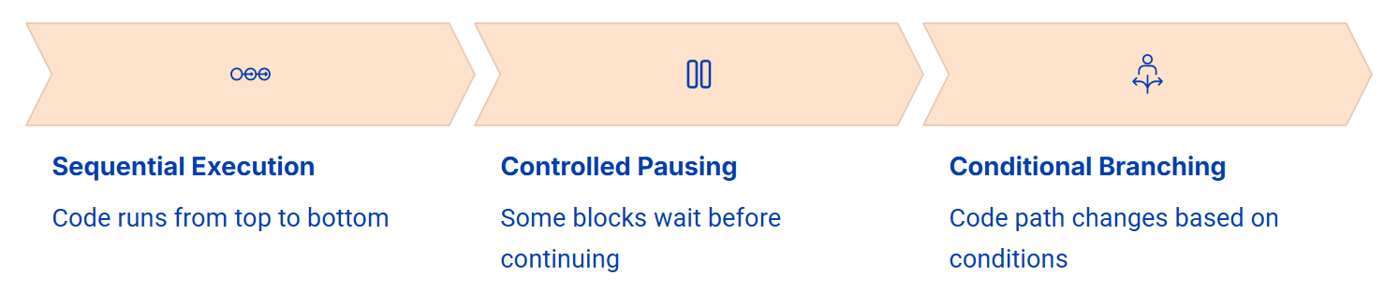
What is Control Flow?
Notes:
Control flow refers to the order in which your code executes. Normally, code runs sequentially from top to bottom - each block executes one after another. However, control flow blocks allow you to change this sequence. Some blocks pause execution until certain conditions are met. Others create branches where the code takes different paths based on conditions. The [Wait until] block is a control flow block that pauses your program until a Boolean condition becomes TRUE. Understanding control flow is essential for creating responsive robot behaviors that react to sensor input.

Slide 36
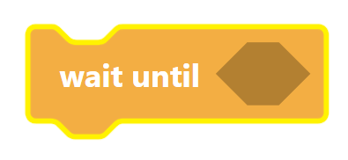
The [Wait until] Block
What It Does
Pauses code execution until the Boolean condition inside reports TRUE
Why It's Useful
Allows robot to wait for specific events before continuing
Notes:
The [Wait until] block is a powerful control block that pauses your program until a specific condition becomes TRUE. Think of it like a traffic light - your robot waits at the red light (FALSE condition) until it turns green (TRUE condition), then continues. The [Wait until] block accepts Boolean conditions in its hexagonal slot. It repeatedly checks this condition, and as soon as it reports TRUE, the code moves to the next block. This is perfect for waiting until the bumper is pressed before turning or stopping.

Slide 38

15 دقيقة

Slide 40
Wall Maze Challenge

Slide 41
Our Goal

Slide 42
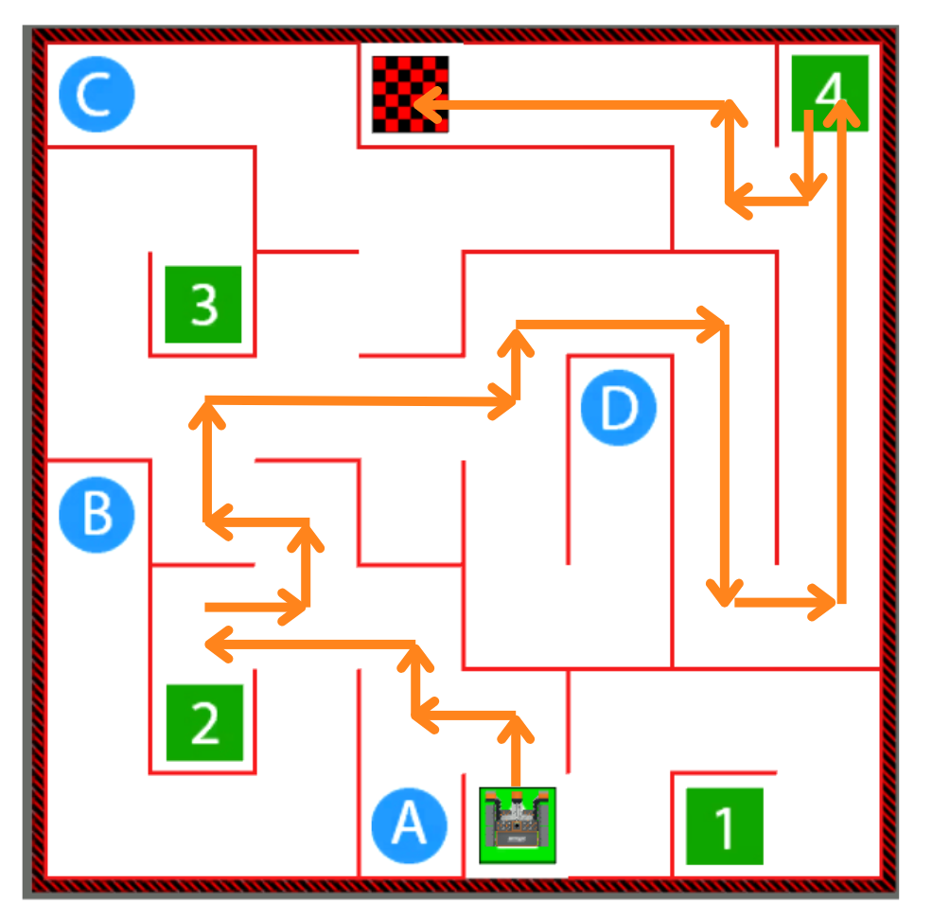
Robot’s Path

Slide 43
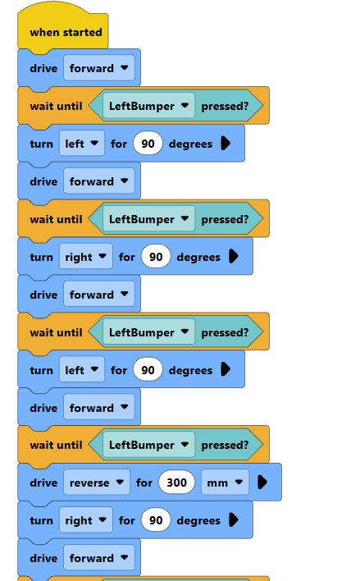
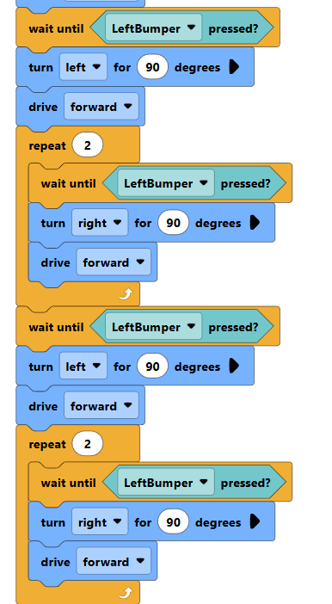
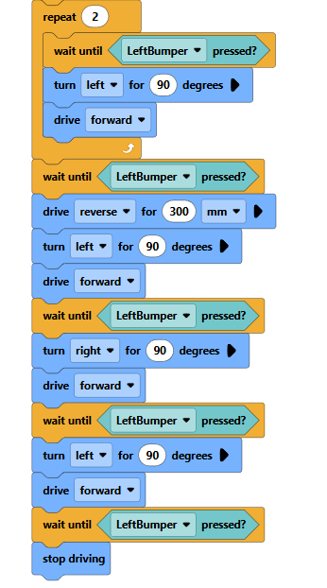

Slide 44
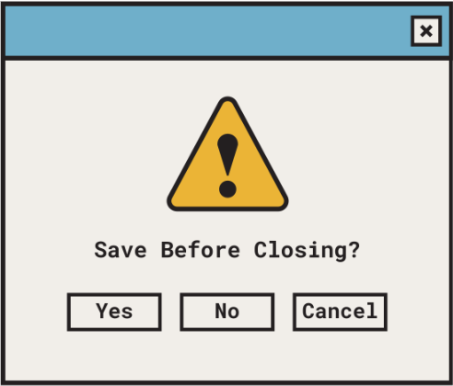
Save your work

Slide 47


